Slide 1
Tracking noise issues with OpenEphys
Korey

Slide 2
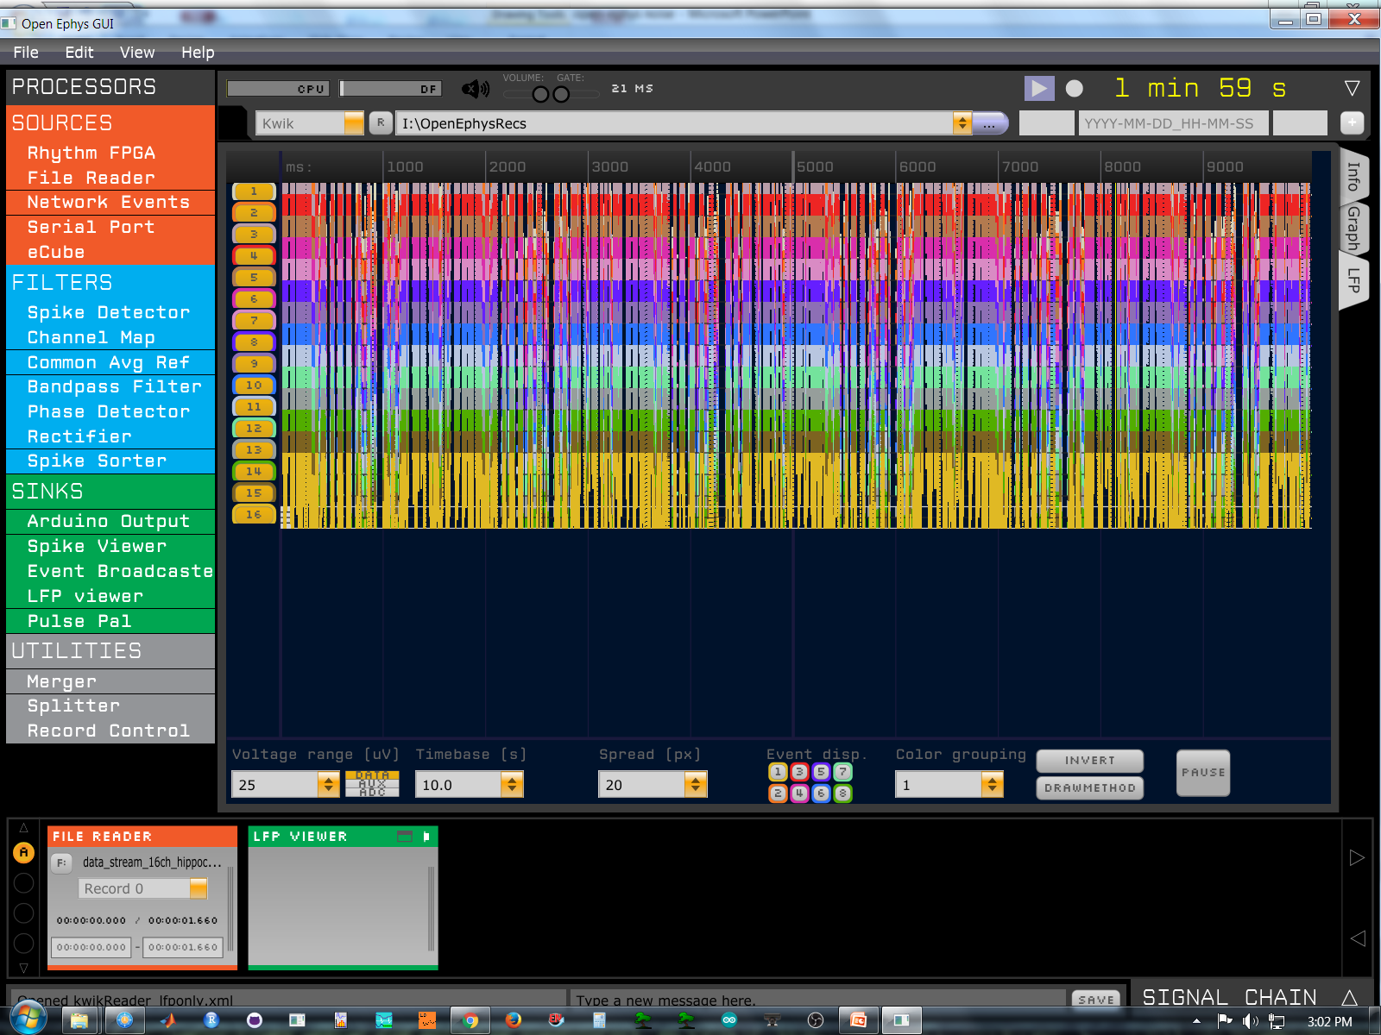
HC control data, 25 uV

Slide 3
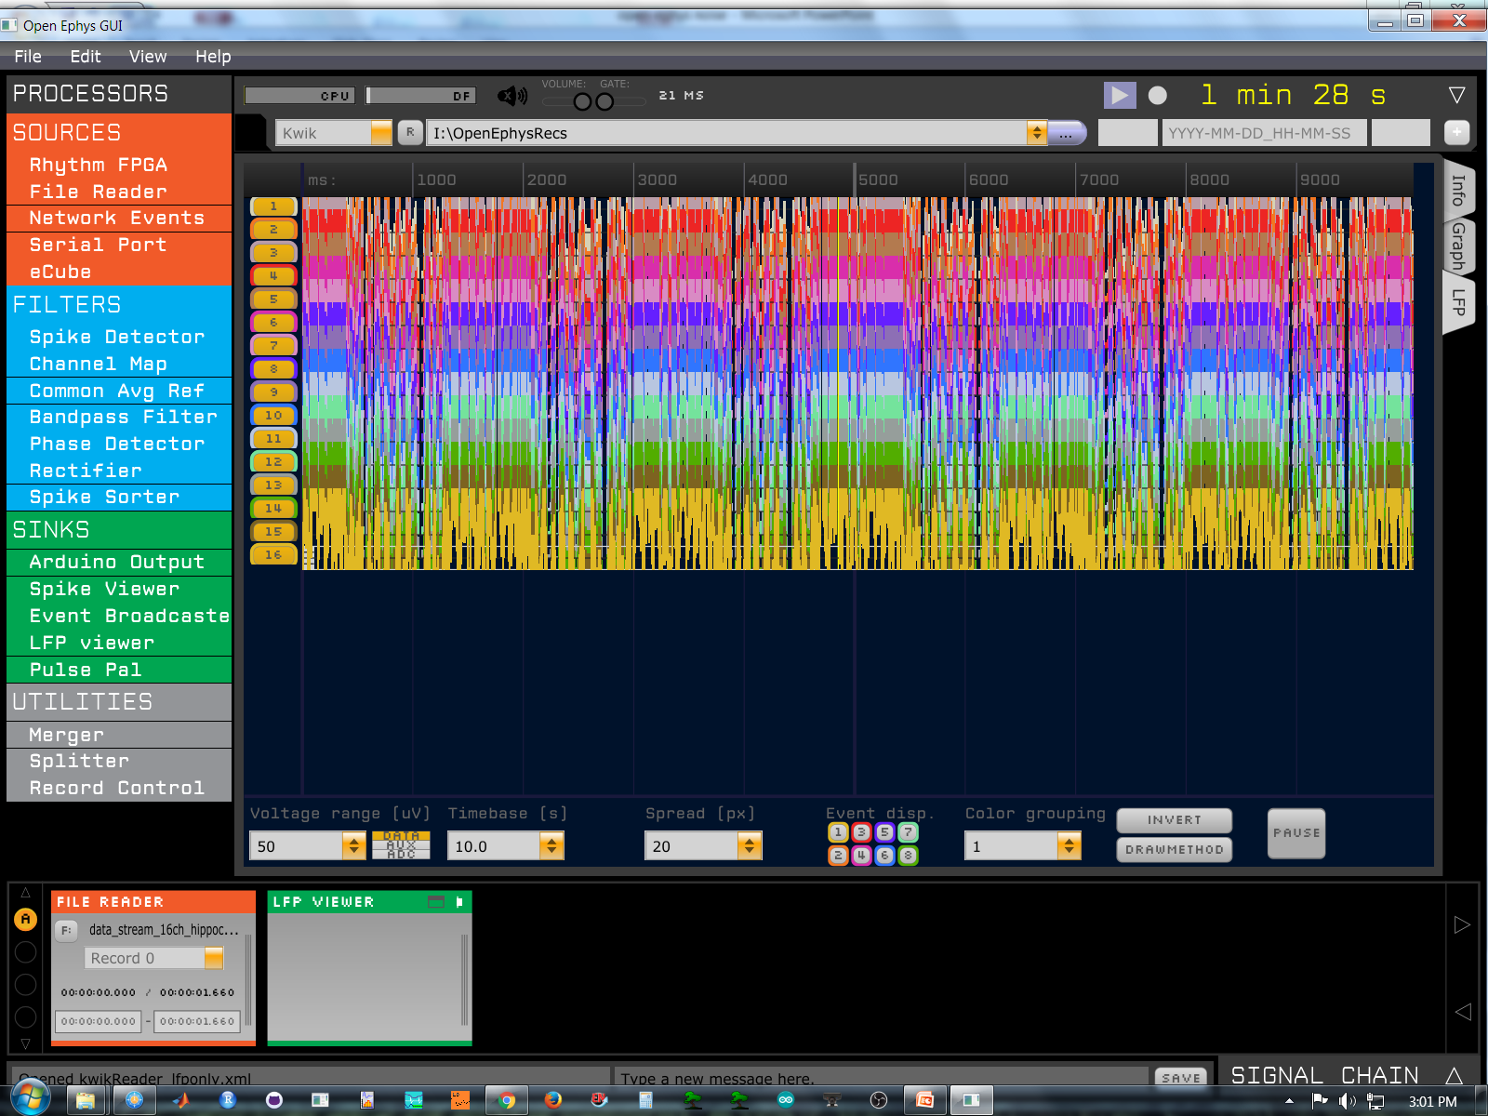
HC control data, 50 uV

Slide 4
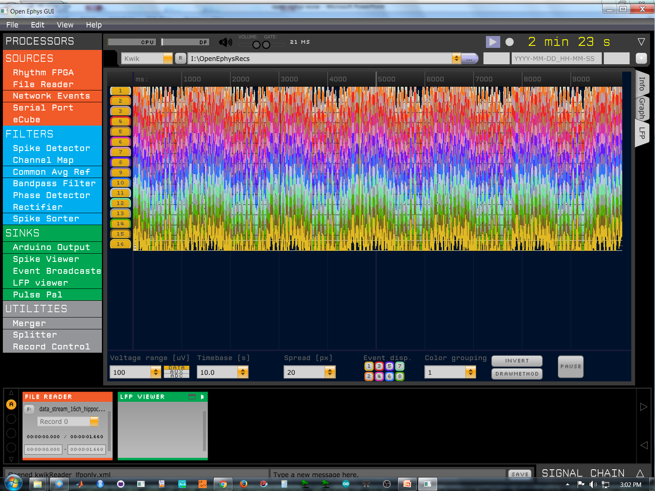
HC control data, 100 uV

Slide 5
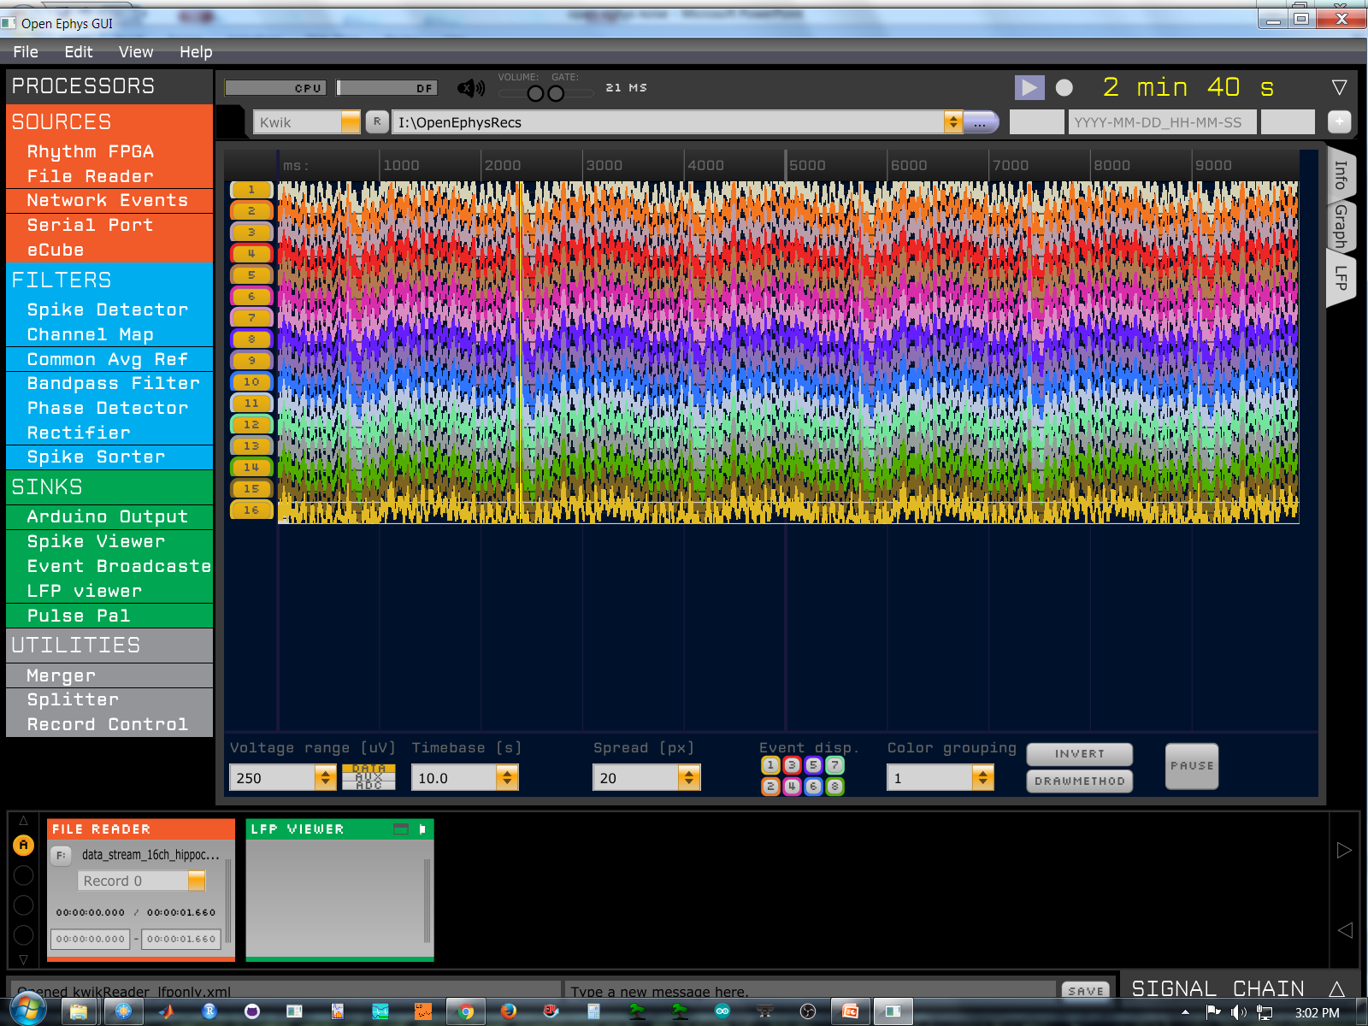
HC control data, 250 uV

Slide 6
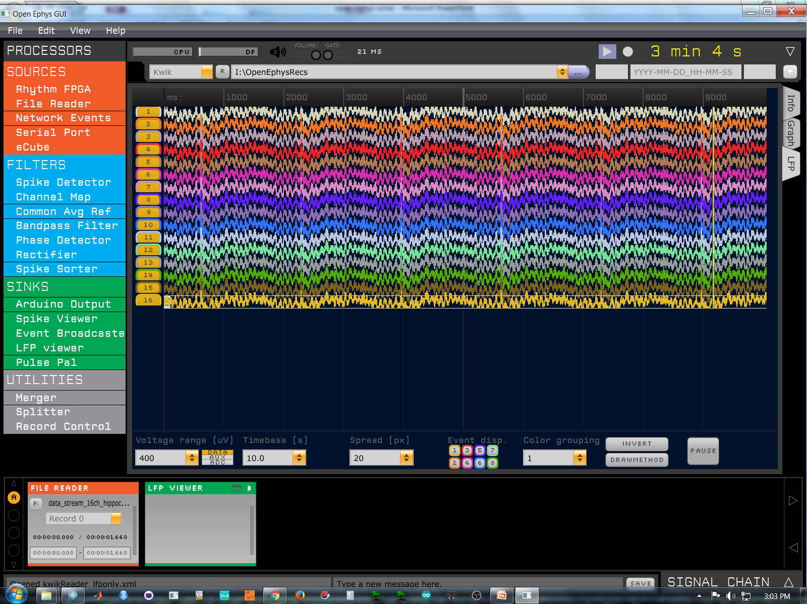
HC control data, 400 uV

Slide 7
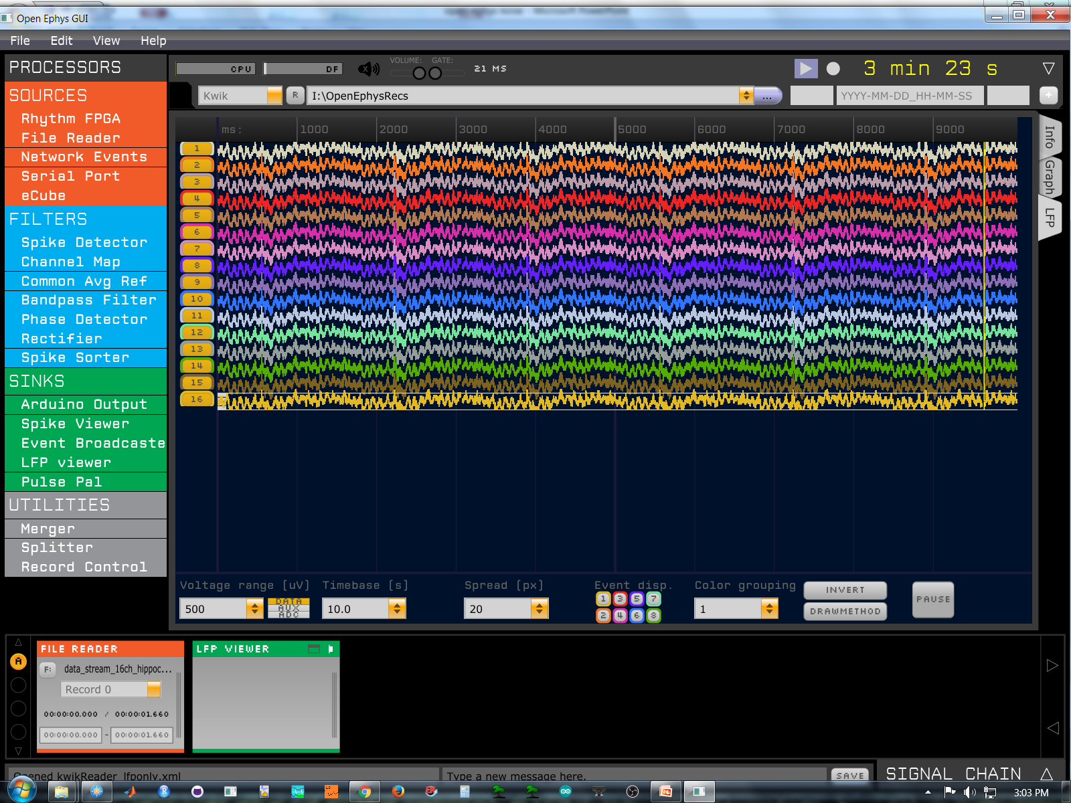
HC control data, 500 uV

Slide 8
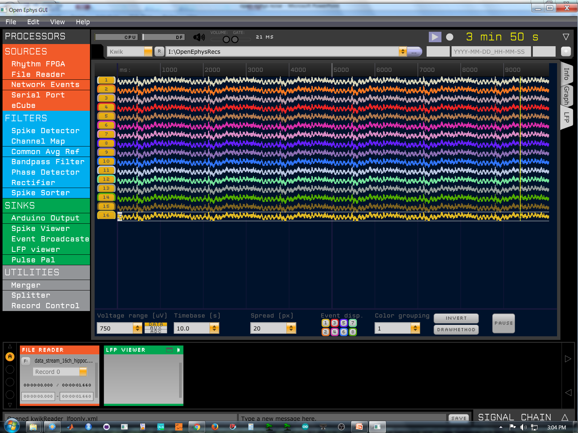
HC control data, 750 uV

Slide 9
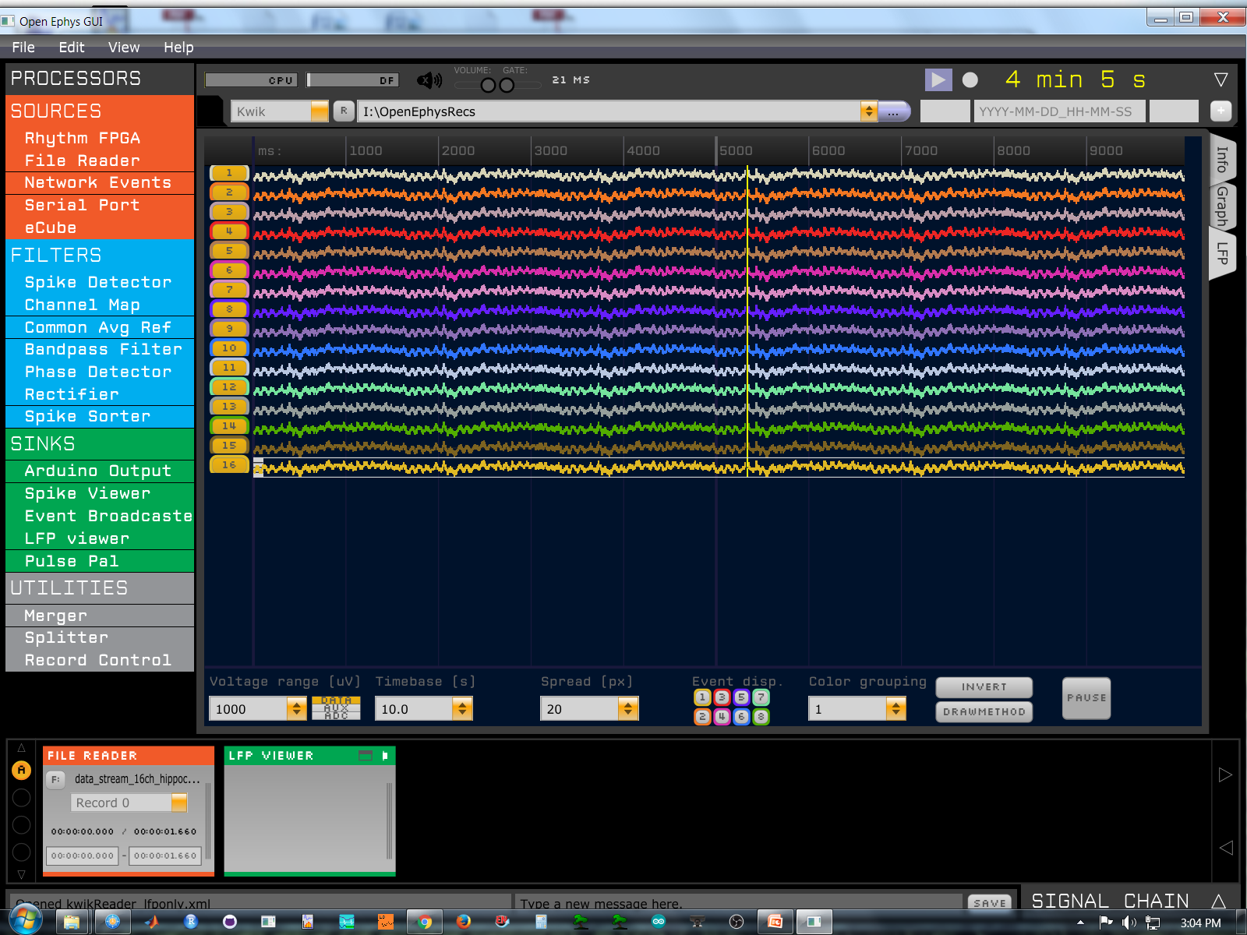
HC control data, 1000 uV

Slide 10
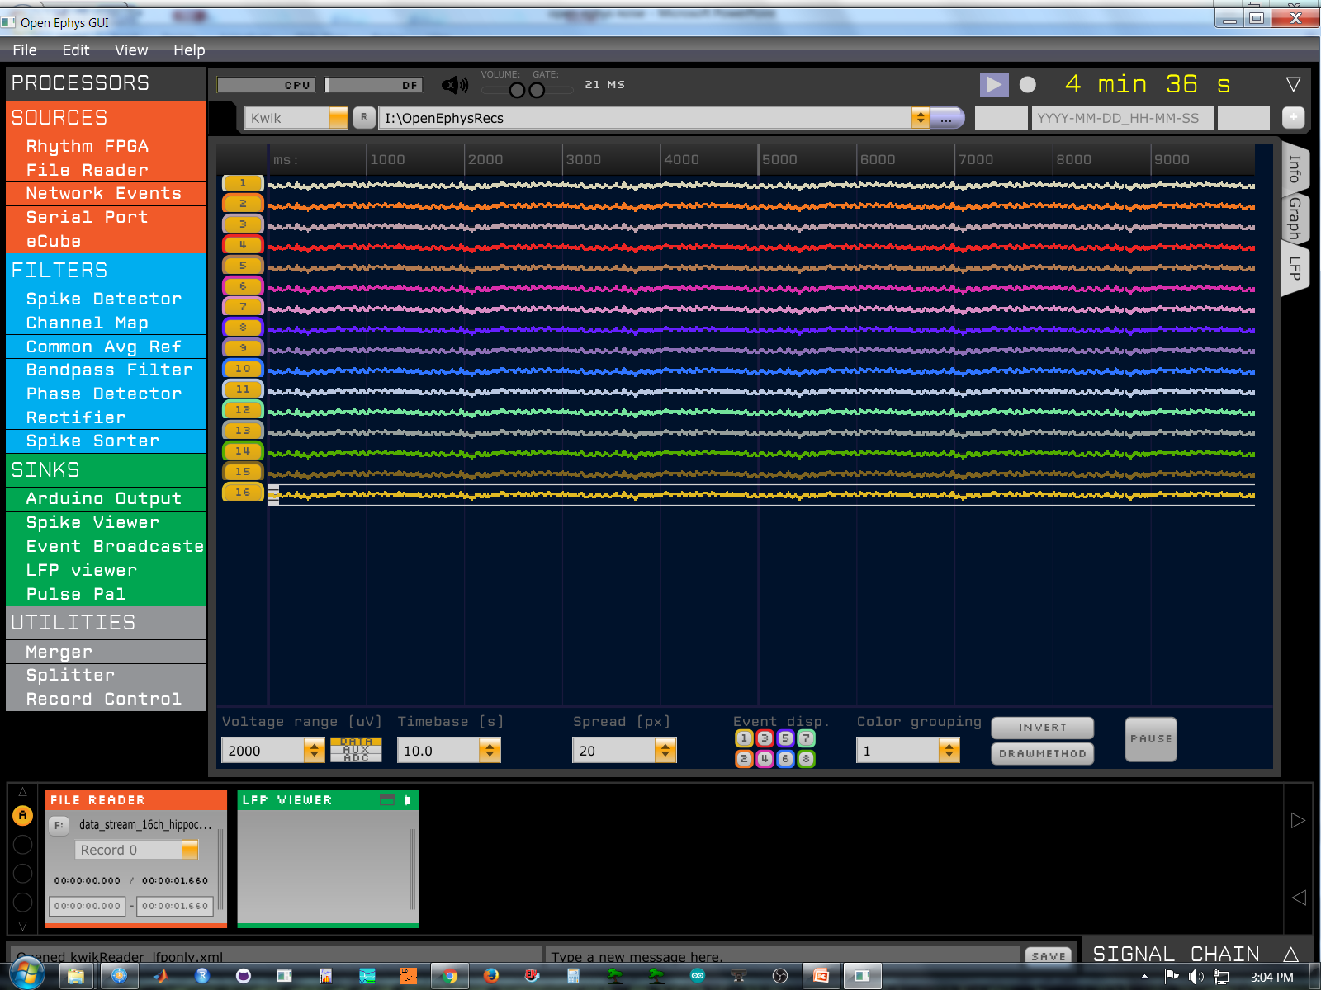
HC control data, 2000 uV

Slide 11

HC control data, 5000 uV

Slide 12

HC control data, 10000 uV

Slide 13
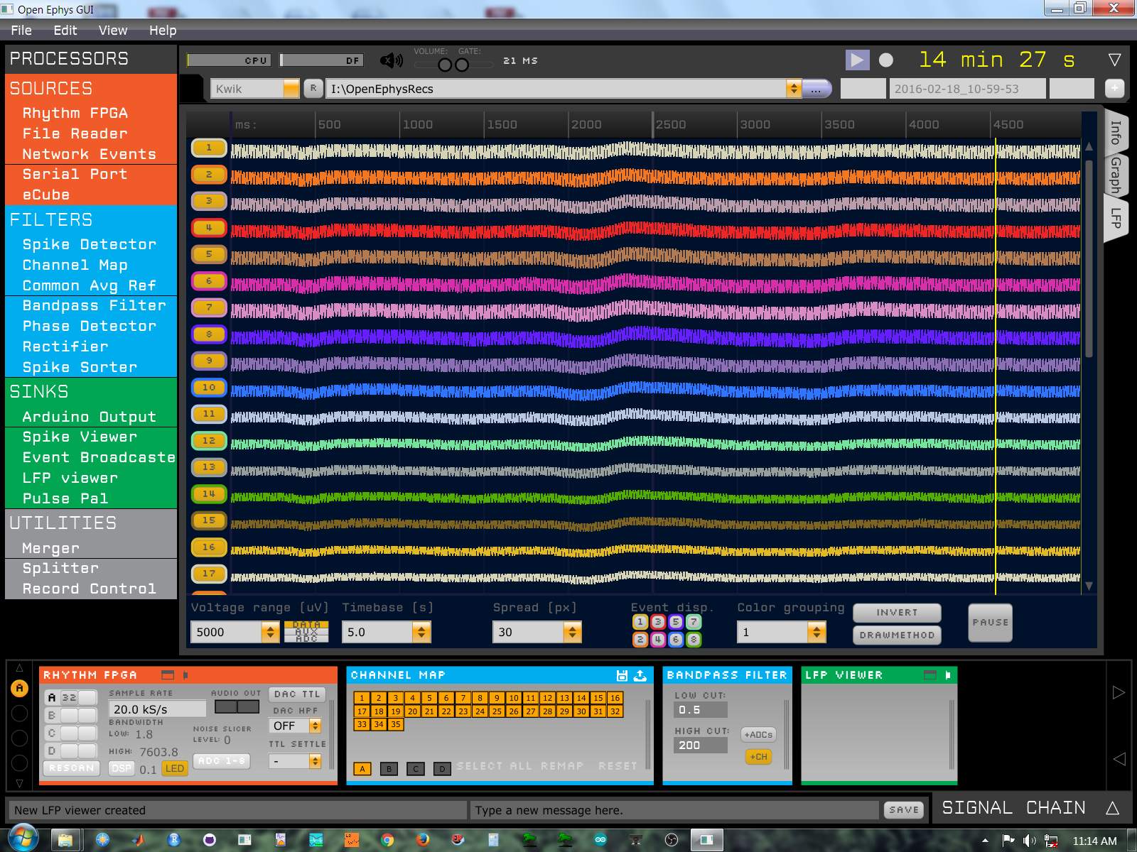
No adapter, 5000uV

Slide 14
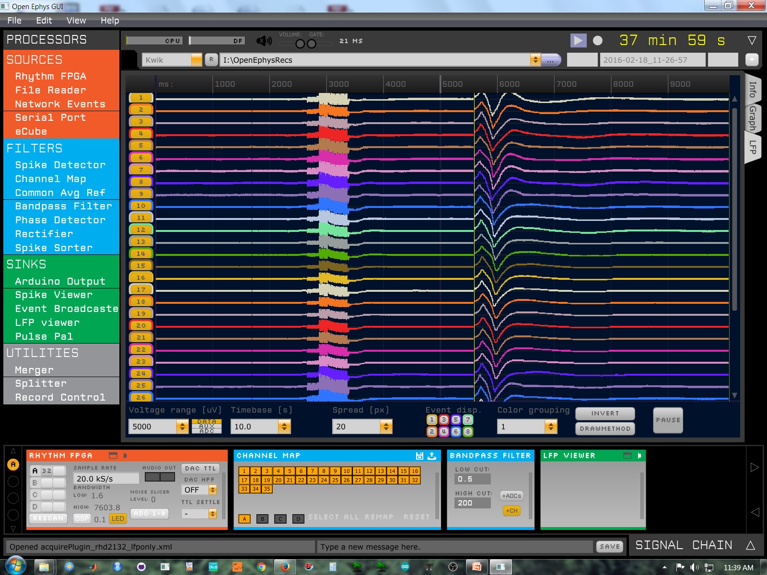
Noise from lights, 5000uV

Slide 15
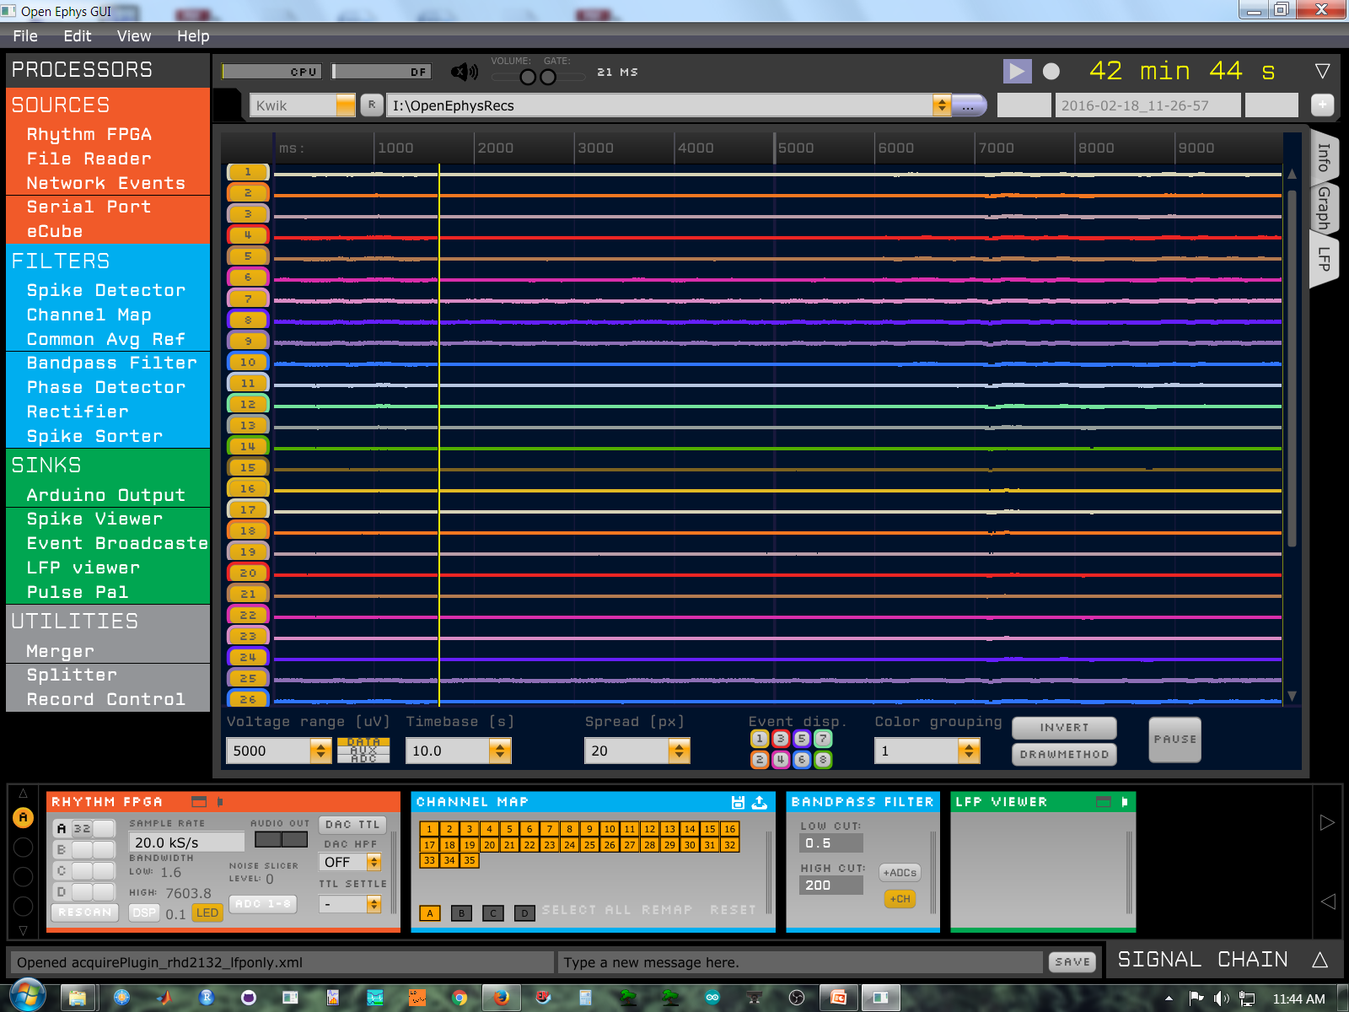
Gnd: lights, faraday, EIB, 5000uV

Slide 16
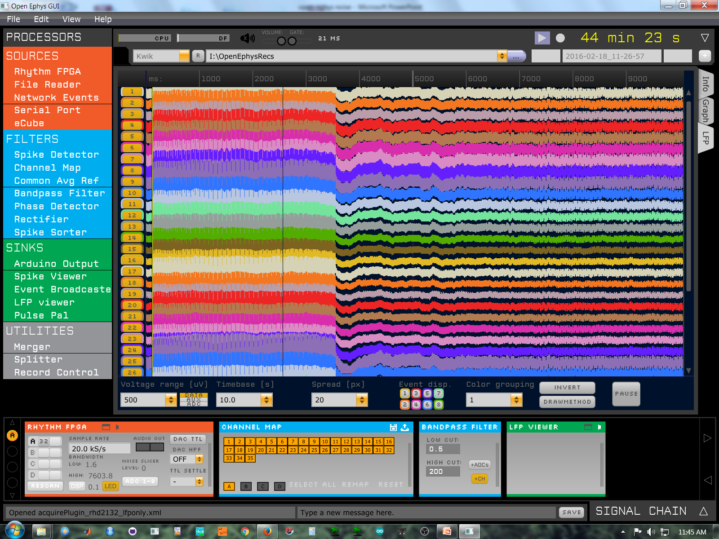
Gnd: lights, faraday, EIB, 500uV

Slide 17
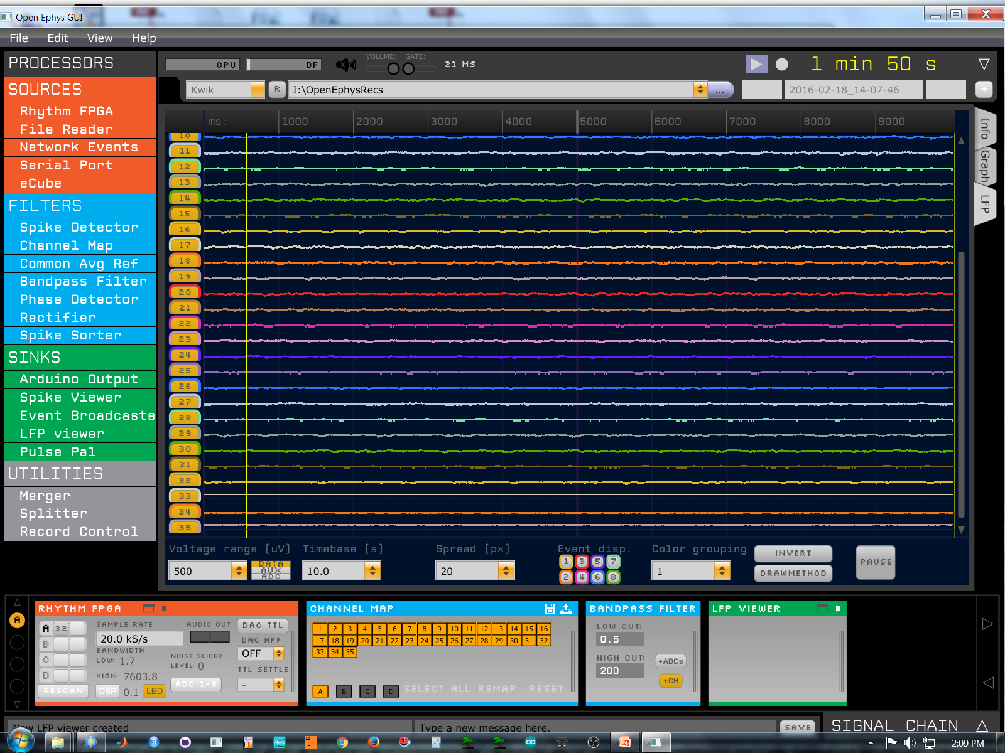
Faraday the headstage, 500uV

Slide 18
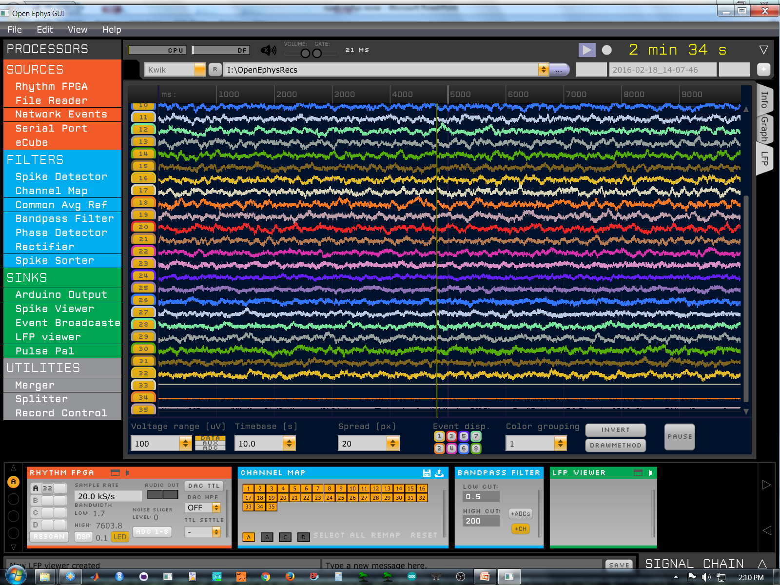
Faraday the headstage, no lights, single mesh 100uV

Slide 19
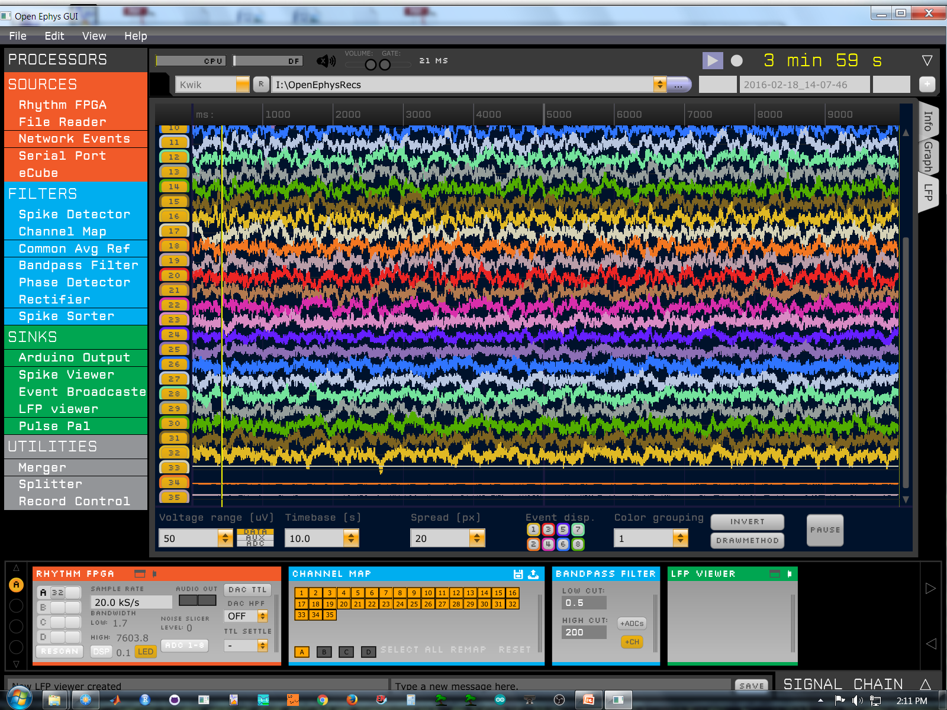
Faraday the headstage, no lights, 50uV

Slide 20
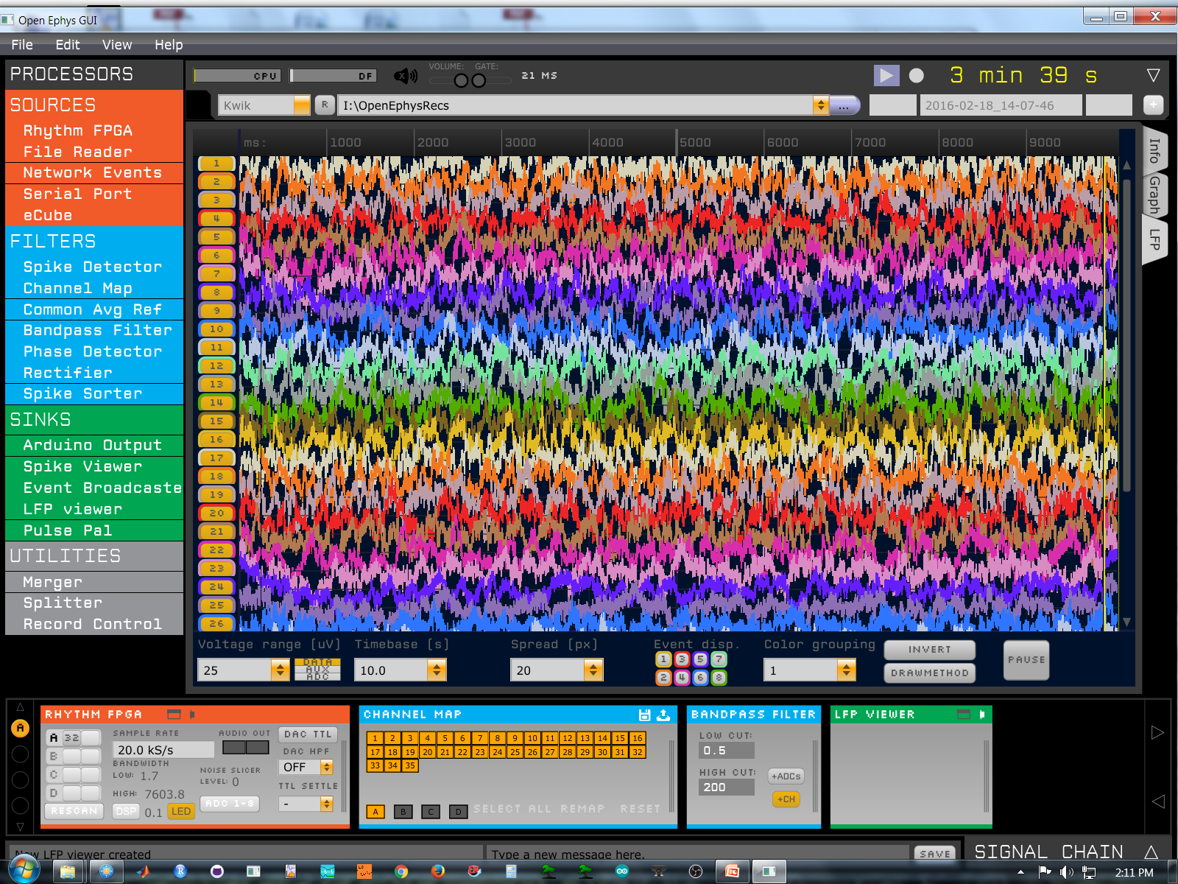
Faraday the headstage, no lights, 25uV

Slide 21
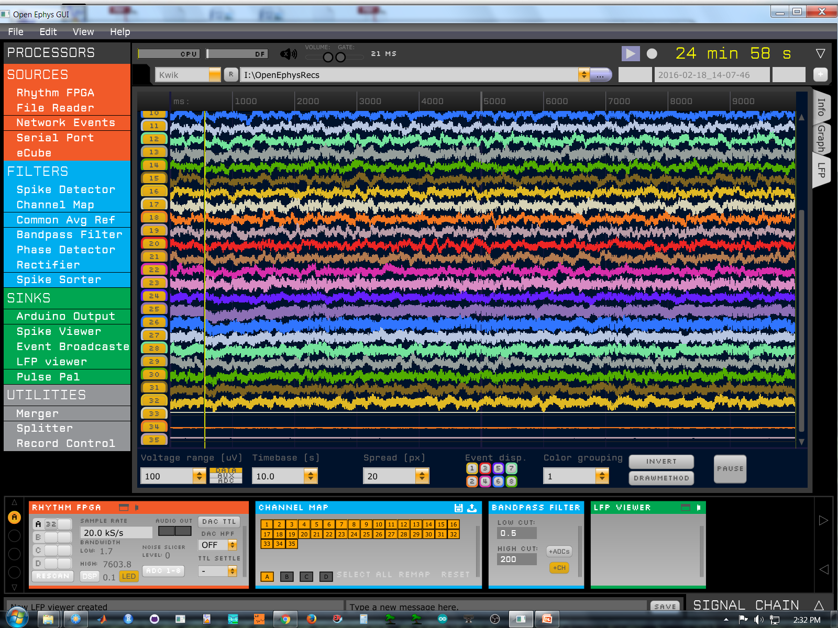
Faraday the headstage, no lights, with heater, double mesh 100uV

Slide 22
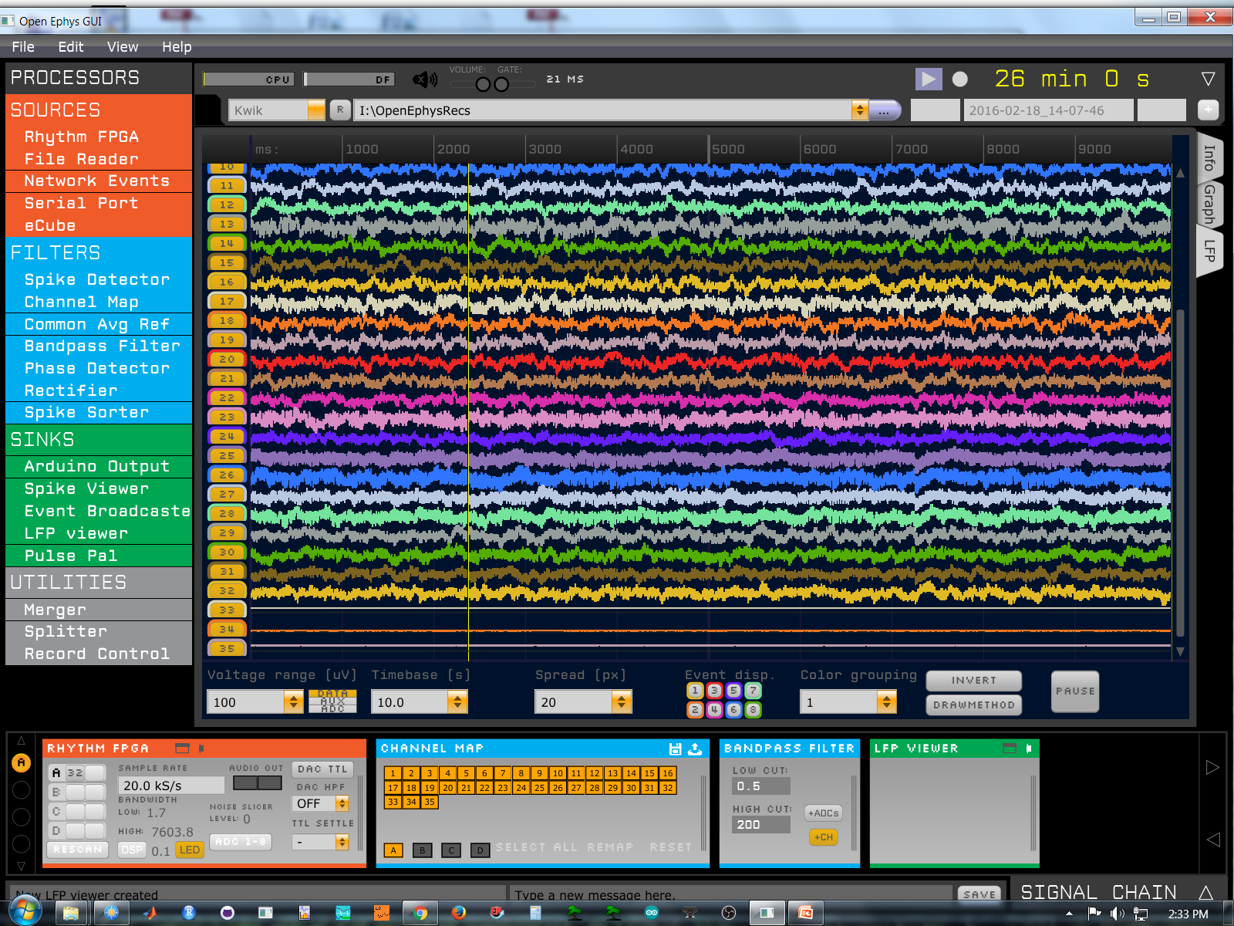
Faraday the headstage, no lights, no heater, double mesh 100uV

Slide 23
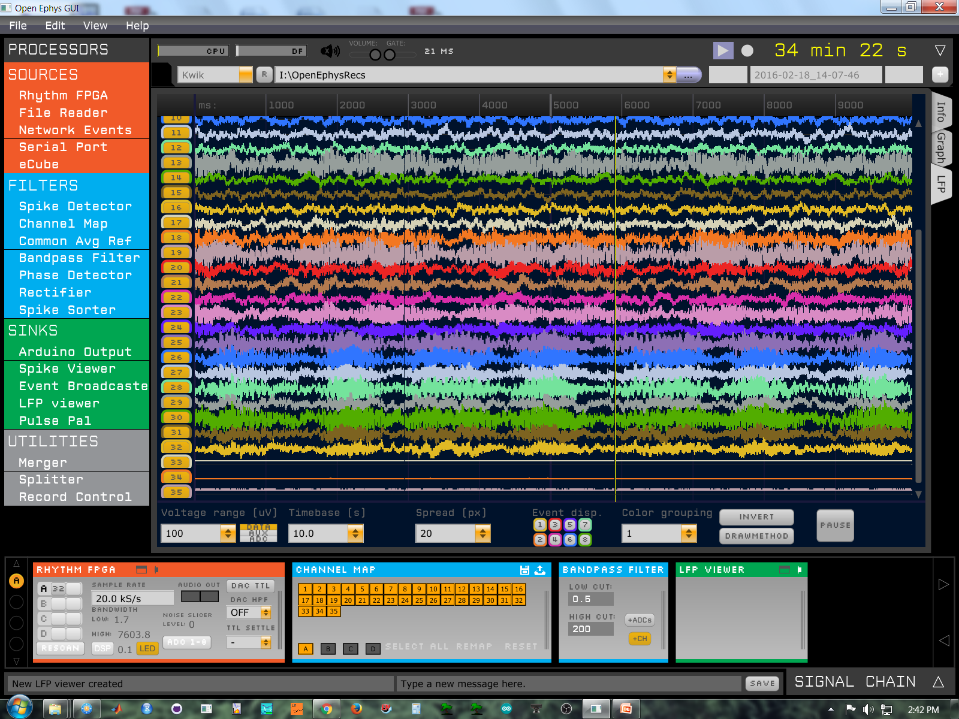
Faraday the headstage, no lights, heater, no HS gnd, double mesh 100uV

Slide 24
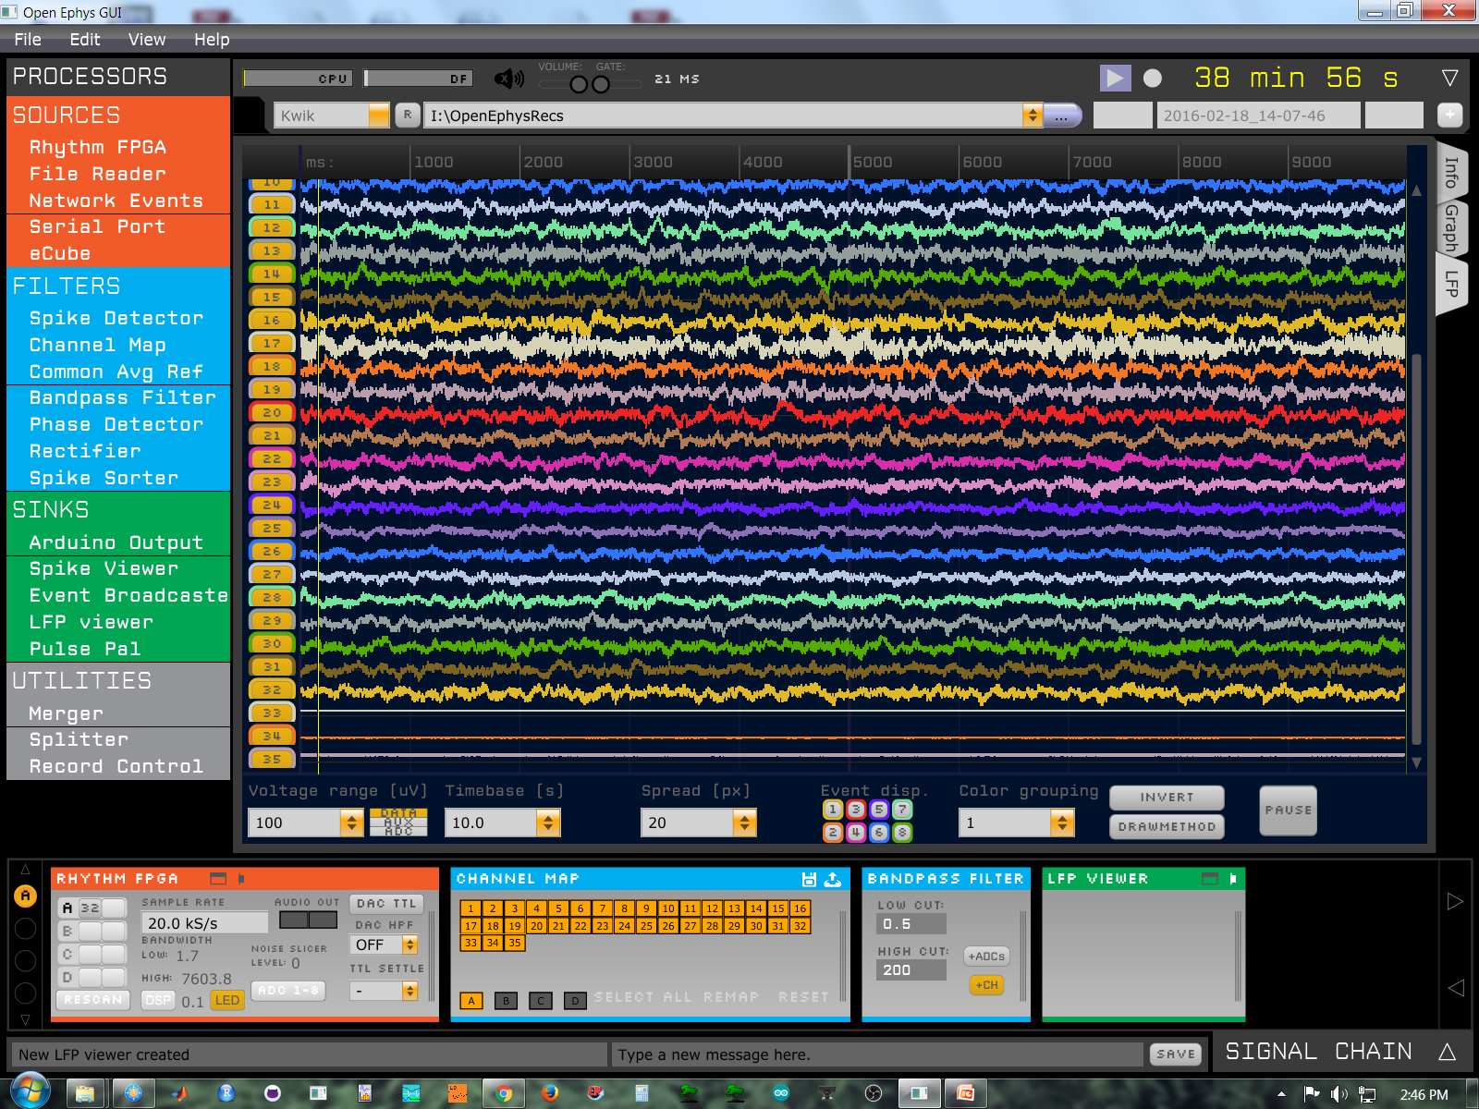
Faraday the headstage, no lights, heater, HS gnd, single mesh, 100uV

Slide 25
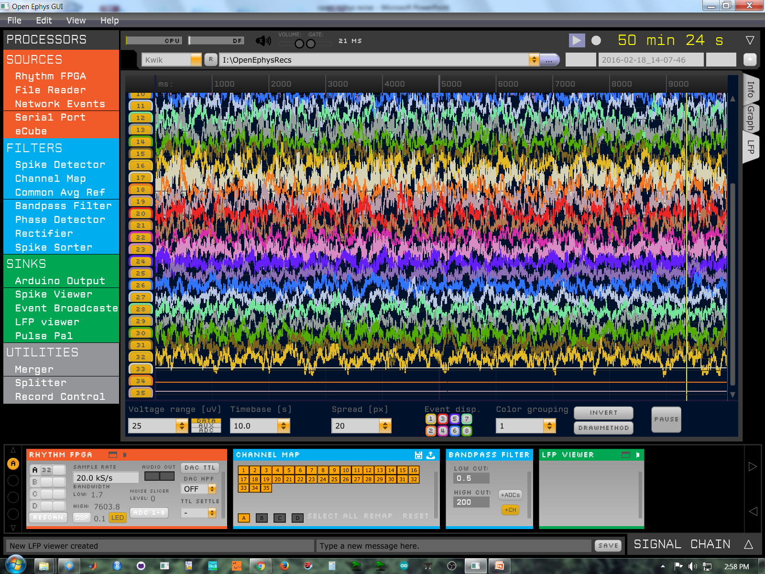
Faraday the headstage, no lights, heater, HS gnd, single mesh, 25uV

Slide 26
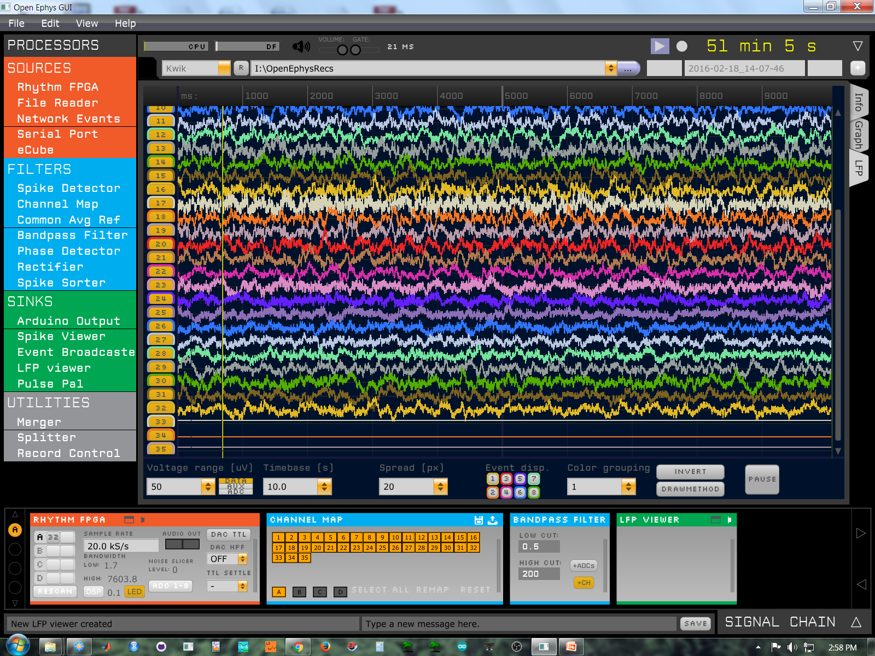
Faraday the headstage, no lights, heater, HS gnd, single mesh, 50uV

Slide 27
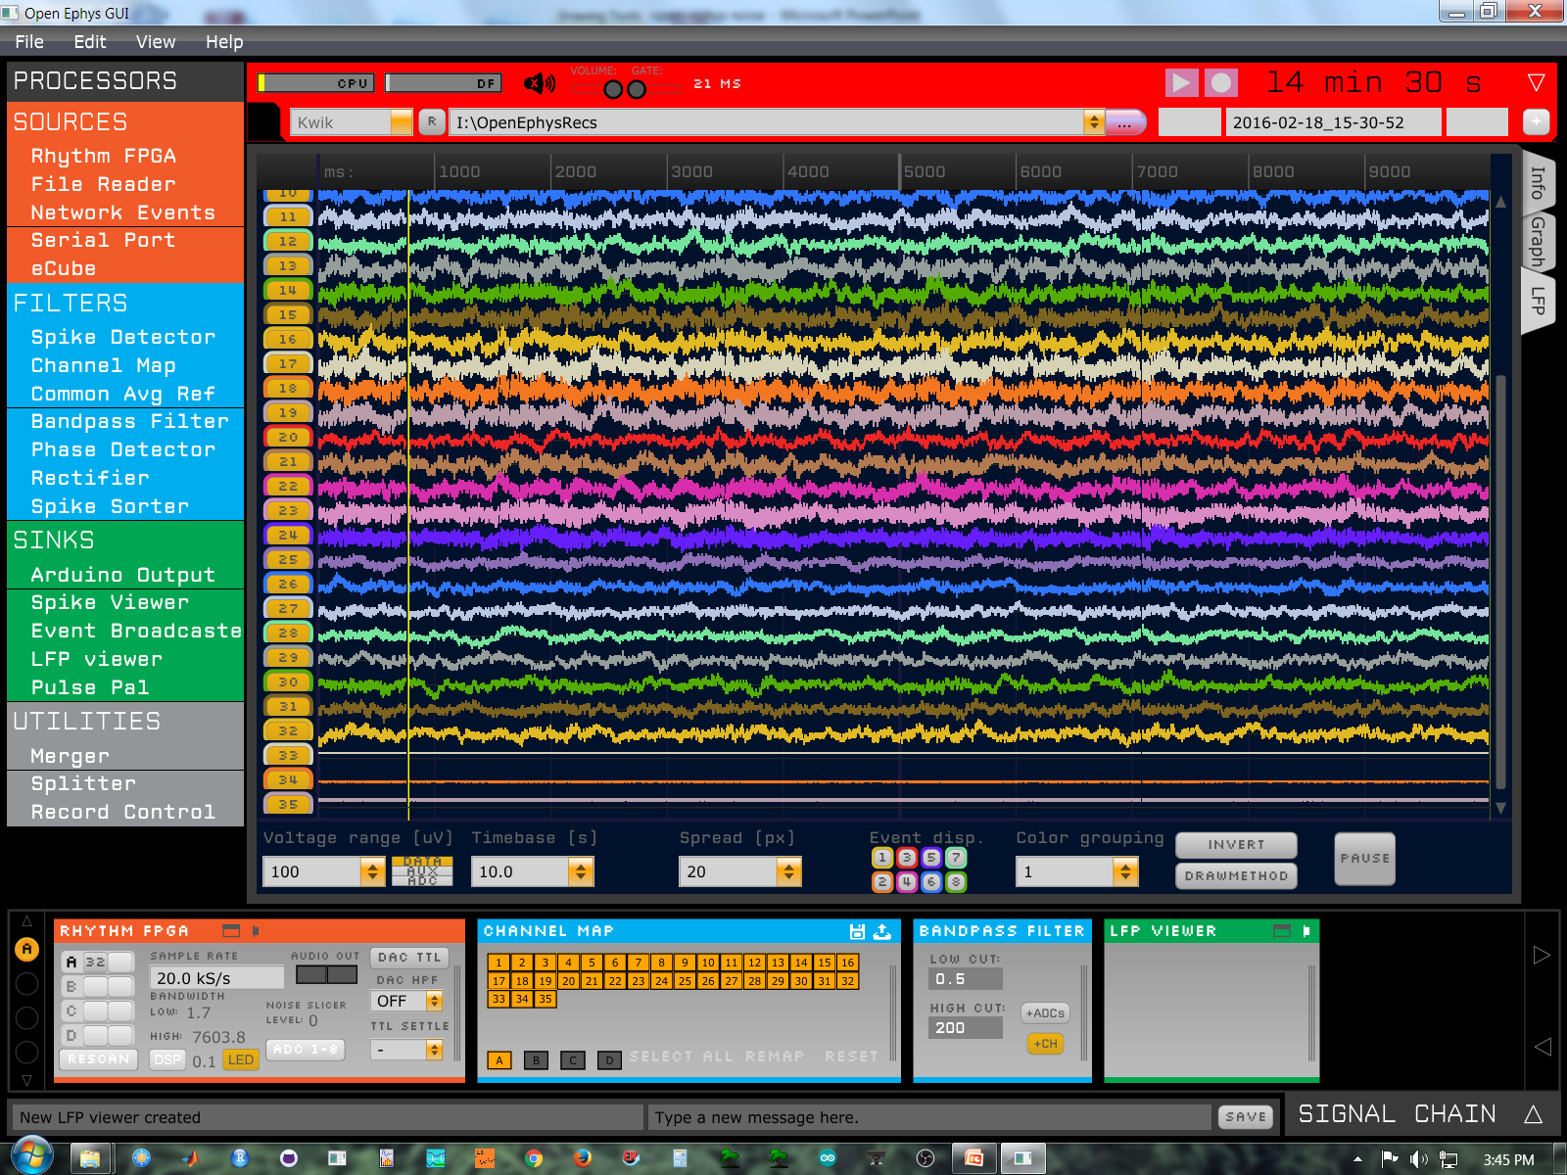
Faraday the headstage, no lights, heater, HS&box gnd, single mesh, 100uV

